Slide 1
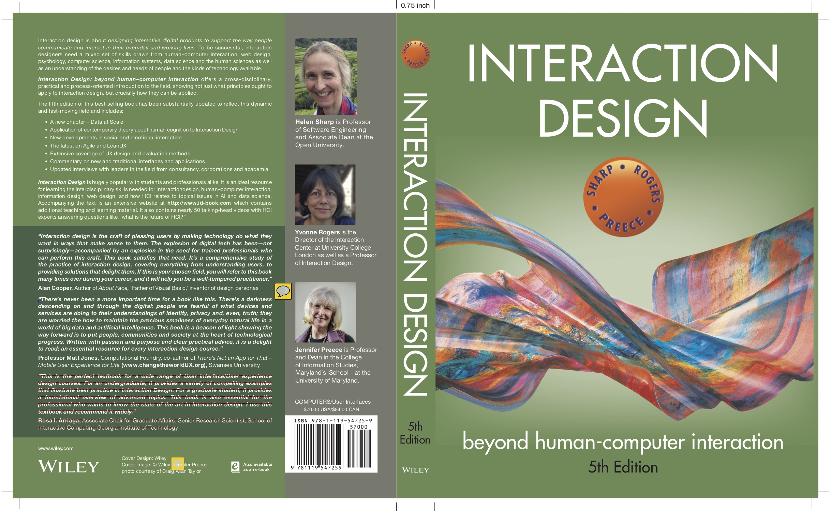
Chapter 13
INTERACTION DESIGN IN PRACTICE

Slide 2
Overview
AgileUX
Design Patterns
Open Source Resources
Tools for Interaction Design

Slide 3
Agile development
Short (one to three week) timeboxes of iterative development (sprint, iteration, cycle)
Early and repeated customer/user feedback
Re-prioritization of work based on customer or user so that emergent requirements can be handled
Many approaches, for example, eXtreme Programming (XP), Scrum, Kanban, and DSDM

Slide 4
Technical Debt in UX
Making compromises that are expedient in short term, but cause problems in long term
Refactoring to correct pragmatic trade-offs
UX debt arises from trade-offs
A history of neglecting UX
Large portfolio of products developed independently

Slide 5
AgileUX
Integrates techniques from interaction design and agile methods
AgileUX requires balancing research and reflection for good UX with rapid iterations incorporating user feedback
In Agile iterations, requirements are elaborated and re-prioritized, rather than specified up-front

Slide 6
AgileUX (continued)
All techniques in UX are still relevant, but when to use and how much needs careful planning
Focus on product, not design, as deliverable
Cross-functional teams
Three practical areas: user research, aligning work practices, and documentation

Slide 7
User research
Seeks to characterize users, tasks, and context through data gathering and analysis
Detailed user research cannot be fitted within a limited timebox
Some user research can be performed in iteration 0 (zero), before implementation starts
Ongoing program of user research over a longer period of time

Slide 8
LeanUX
Create and deploy products quickly to get real user feedback for future developments
Tight iterations of build-measure-learn
Minimum viable product tests assumptions
Source: Gothelf, J. with J. Seiden (2016) Lean UX, 2nd edition, O’Reilly.

Slide 9
Aligning work practices
Designing a complete product upfront causes problems because of re-prioritization
Some upfront work is needed (technical and UX)
Use a parallel tracks approach:
Create product vision before development starts
Do design work one iteration ahead of development
Some teams work two iterations ahead

Slide 10
Parallel tracks approach to AgileUX
Source: Sy, D. (2007) Adapting usability investigations for development, Journal of Usability Studies 2(3), May, 112–130. User Experience Professionals Association.

Slide 11
Aligning work practices
Advantages of parallel tracks approach:
No design time wasted on features not implemented
Usability testing and contextual inquiry could be done on the same customer visit, saving time
Timely feedback on the designs was received from developers and customers
Agile flexibility supports schedule changes if a problem is found
Parallel tracks is commonly used

Slide 12
Documentation
Common communication approach for UX designers
Agile encourages minimal documentation so more time can be spent on design and discussion
Only use documentation where needed. Ask:
Can the amount of time spent on documentation be reduced?
Who uses documentation?
What is the minimum needed by customers?
How efficient is the sign-off process?
Is there duplication anywhere?
How polished does documentation need to be?

Slide 13
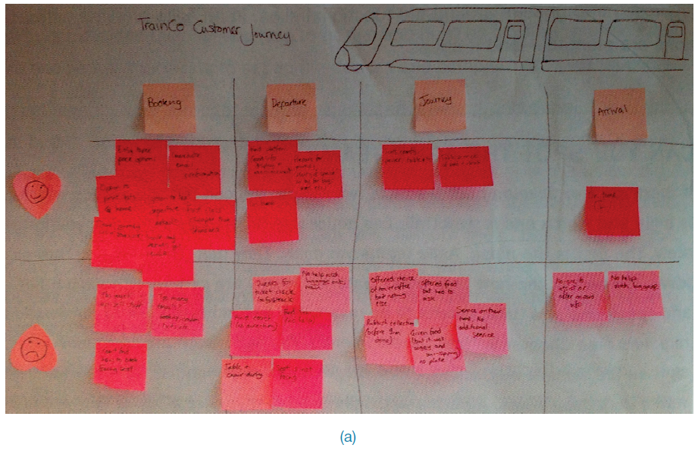
Documentation: How polished? (low fidelity)
Source: Ratcliffe, L. and McNeill, M. (2012) Agile Experience Design. New Riders.

Slide 14
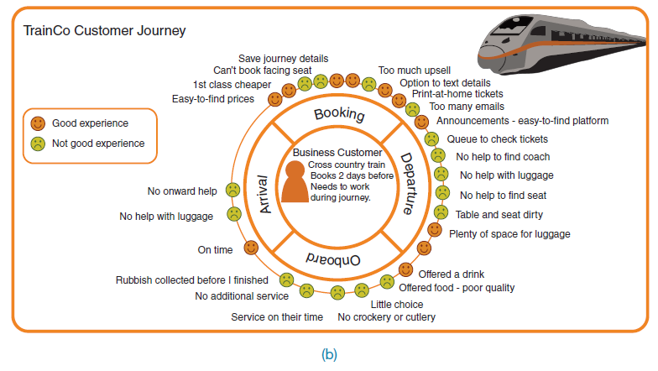
Documentation: how polished? (high fidelity)
Source: Ratcliffe, L. and McNeill, M. (2012) Agile Experience Design. New Riders.

Slide 15
Design Patterns
Capture design experience:
A solution to a problem in a context
Can be instantiated in many ways: generative
Patterns may be individual, in languages, in catalogues, galleries, or libraries
Patterns often are associated with software components, for example, GitHub or platform websites

Slide 16
Design Patterns: Carousel
Carousel pattern as example

Slide 17
Bad Design Patterns
Capture design experience — but that doesn’t necessarily mean good design:
Anti-patterns: Don’t do it this way!
Dark patterns: deliberate tricks

Slide 18
Open Source Resources
Components, frameworks, systems available free of charge
Community-driven
Available for interaction design:
Design pattern libraries
Bootstrap framework

Slide 19
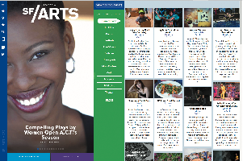
Open Source Resources
Source: Didier Garcia/Larson Associates

Slide 20
Tools for Interaction Design
Tools support all aspects of the design process:
Creativity, sketching, simulation, brainstorming, library search, mind mapping, and video capture
Tools integrate together to speed up prototyping
Tooling landscape changes all the time
Interactive wireframes or mockups can be produced using, for example:
Moqup©
Balsamiq©
Axure©
Higher-fidelity prototypes can be produced by linking interactive wireframes to design pattern library with software components

Slide 21
Summary
AgileUX refers to approaches that integrate UX design and agile development
Needs a balance between research and reflection, and rapid iterations
Requirements are repeatedly re-prioritized, which seeks to avoid wasted effort
UX design activities need careful planning: when, how much, and how to take forward
Design patterns and implementation libraries support good user experience design
Open source resources, for example, on GitHub, make development of standard applications easier and quicker
A range of automated tools to support interaction design in practice is available

